Slide 1
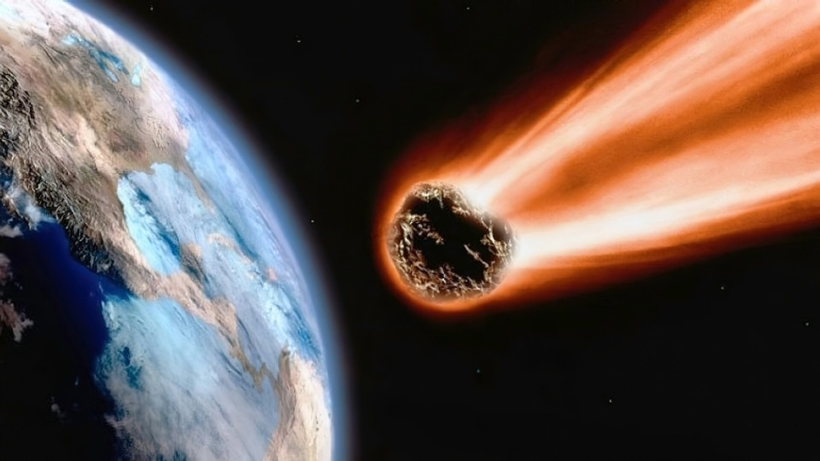
Found Meteorite Data Analysis
E. Baldwin

Slide 2
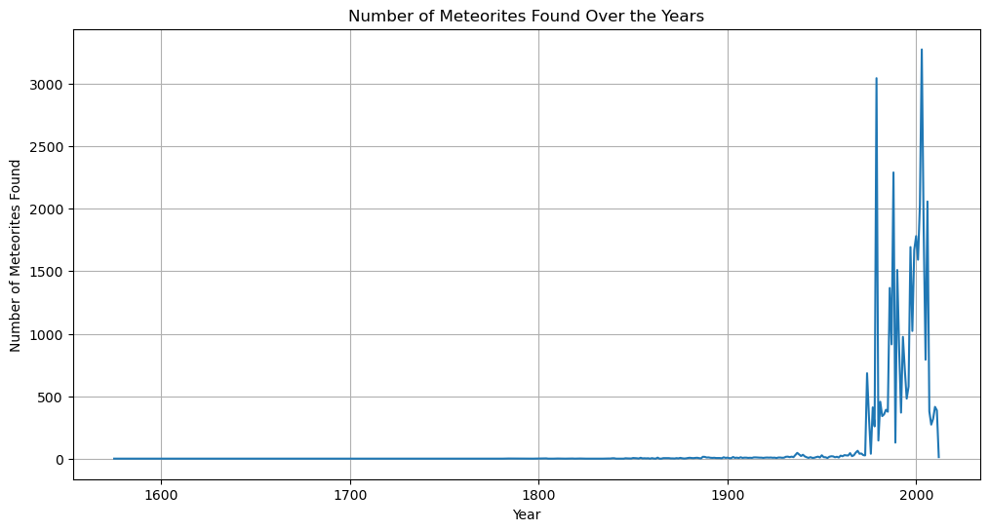
Total Meteorites Found

Slide 3
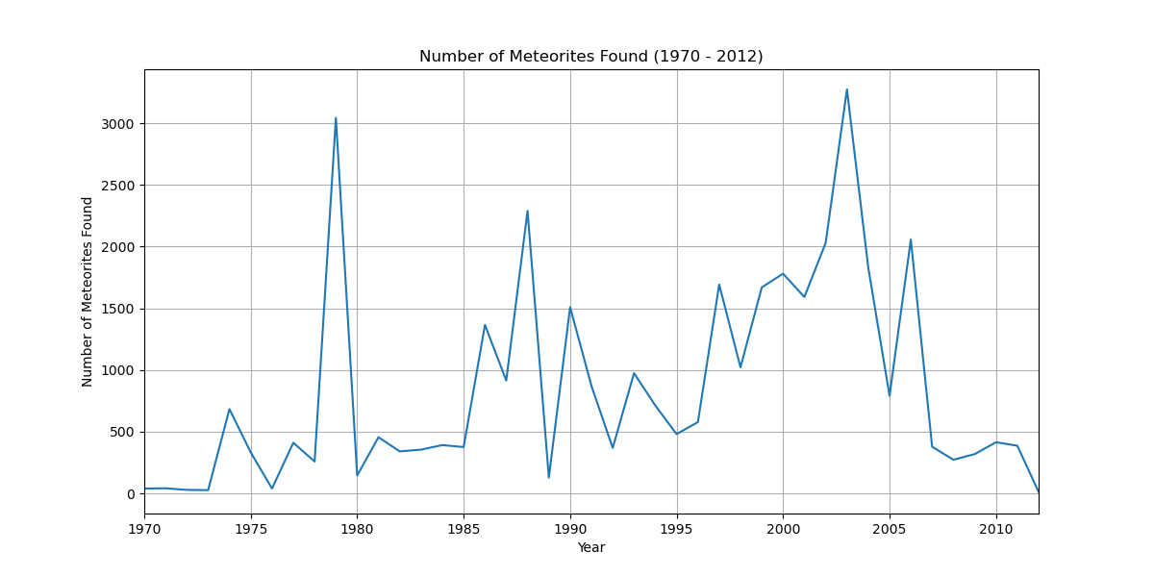
Total Meteorites Found (1970 – 2012)

Slide 4
Top 3 Meteorites Found
L6 Chondrites:
L (Low Iron) Chondrites: Typically around 20-25% by weight.
Type 6 (Petrologic Type): Extensive thermal metamorphism.
(Chondrules are generally indistinct, as they have been recrystallized and homogenized by heating.)
H5 Chondrites:
H (High Iron) Chondrites: Typically around 25-30% by weight.
Type 5 (Petrologic Type): Moderate thermal metamorphism.
(Chondrules are still present but may show signs of recrystallization.)
L5 Chondrites:
L (Low Iron) Chondrites: Typically around 20-25% by weight.
Type 5 (Petrologic Type): Moderate thermal metamorphism.
(Chondrules are still present but may show signs of recrystallization.)
Chondrules are small, round particles found within chondritic meteorites, which are some of the oldest and most primitive materials in the solar system. They are typically composed of silicate minerals and can range in size from a fraction of a millimeter to several millimeters in diameter.

Slide 5
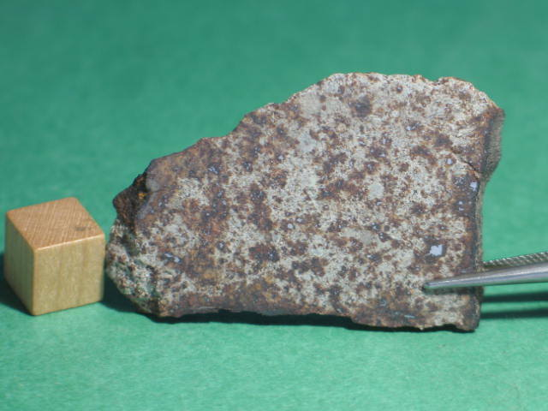
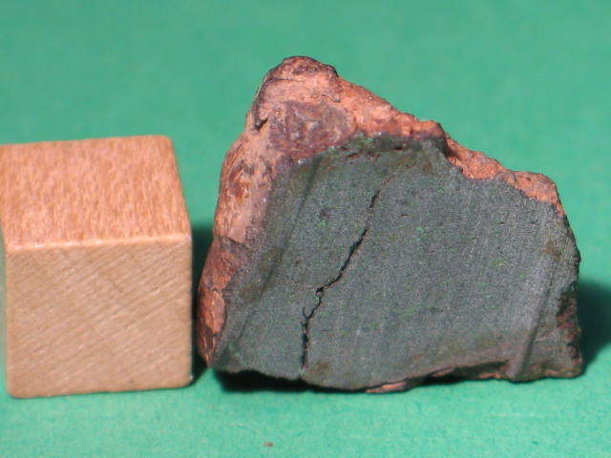
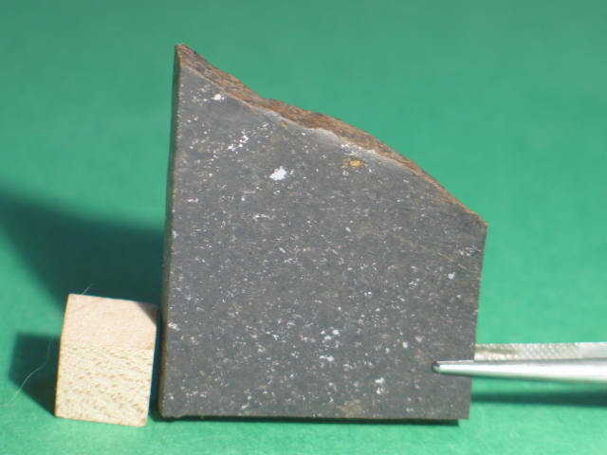
Top 3 Meteorites Found
L6
H5
L5

Slide 6
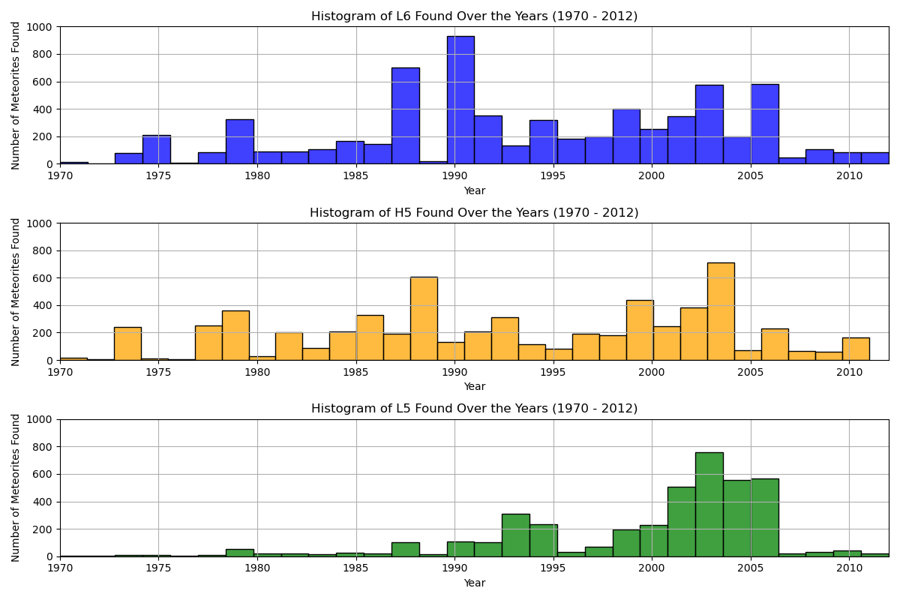
Top 3 Found 1970 – 2012 (Hist)

Slide 7
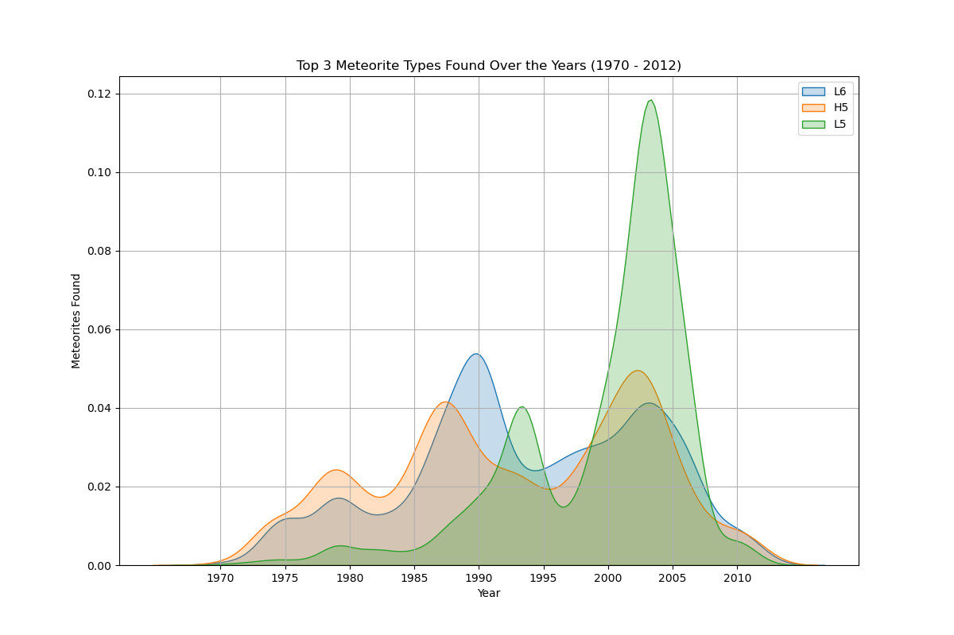
Top 3 Found 1970 – 2012 (KDE)

Slide 8
Histogram vs KDE

Slide 9
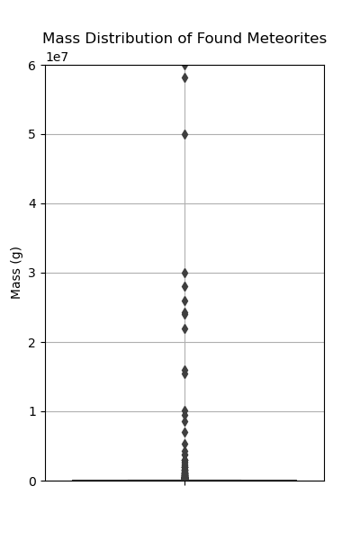
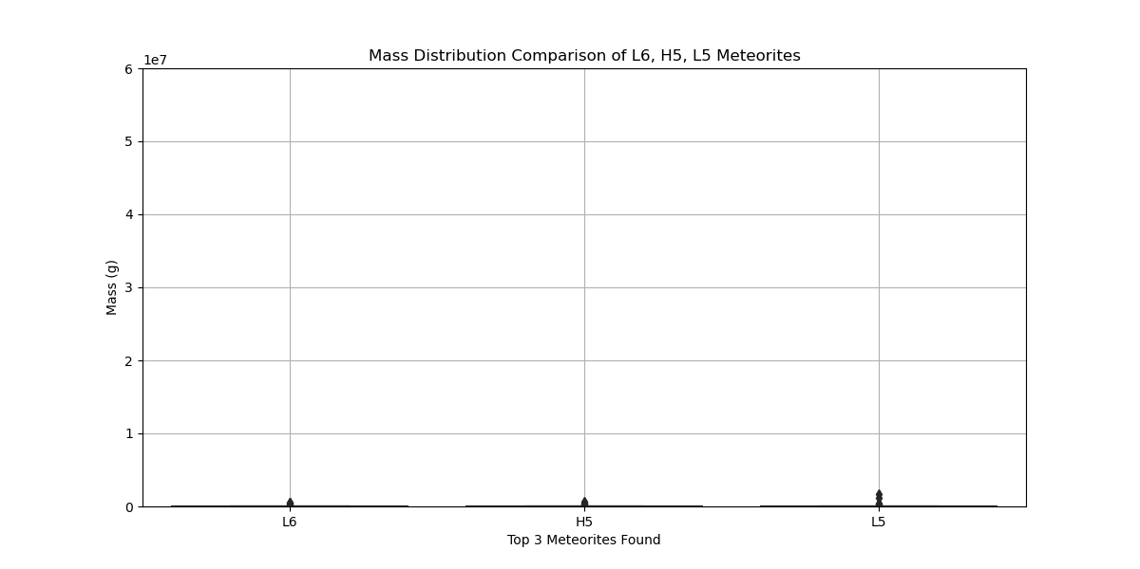
Meteorite Mass Totals
60,000,000 (g)

Slide 10
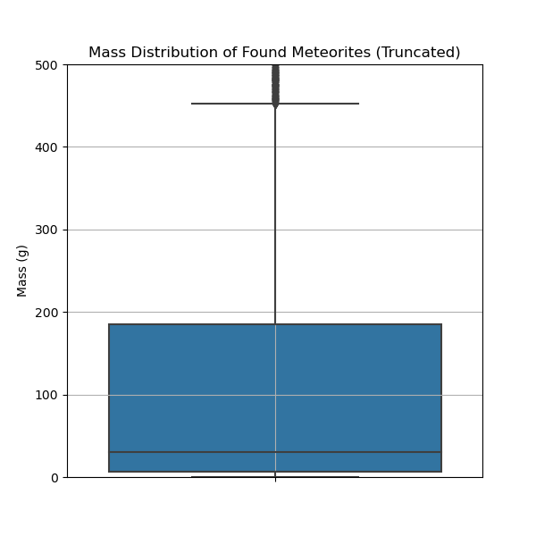
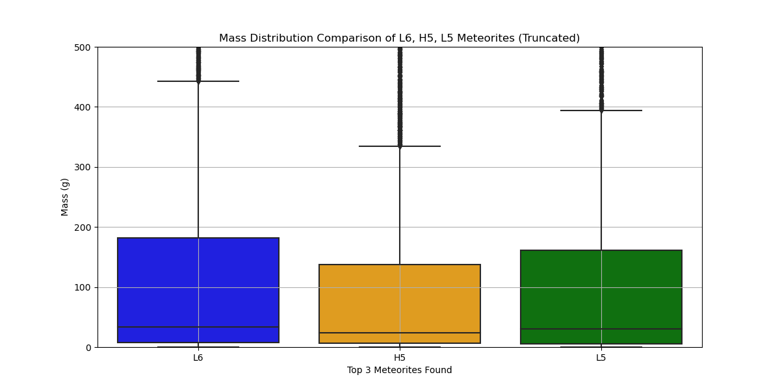
Meteorite Mass (Truncated)

Slide 11
Title

